Slide 1
Introduction to Bootstrap
Week 02.

Slide 2
Objectives
Describe the Bootstrap framework;
Demonstrate how to use Bootstrap to create responsive web pages;

Slide 3
Tools Required
Visual Studio Code
Browser
Google Chrome (recommended)
Mozilla Firefox

Slide 4
BOOTSTRAP 4

Slide 5
What is Bootstrap?
Free front-end framework for faster and easier web development
Includes HTML and CSS based design templates
Gives you the ability to create responsive designs that automatically adjust themselves to look good on all devices

Slide 6
Why Bootstrap?
Easy to use: all you need is basic knowledge of HTML and CSS
Responsive features: automatically adjusts to different screen size
Mobile-first approach: design is focused on the online experience for mobile
Browser compatibility: compatible with all modern browsers

Slide 7
Create a web page with Bootstrap 4
Create a new HTML file in your C:\Users\USERNAME\Desktop\cdev\week2\ bootstrap_example.html
Include the following HTML codes in the file (Can use the shortcut !(exclamation) followed by “tab” key
<!DOCTYPE html>
<html lang="en">
<head>
<meta charset="UTF-8">
<meta http-equiv="X-UA-Compatible" content="IE=edge">
<meta name="viewport" content="width=device-width, initial-scale=1.0">
<title>Document</title>
</head>
<body>
</body>
</html>

Slide 8
Create a web page with Bootstrap 4
Include the Bootstrap CSS and Javascript files in the HTML by adding the following codes inside the <head> element:
<link rel="stylesheet" href="https://maxcdn.bootstrapcdn.com/bootstrap/4.1.3/css/bootstrap.min.css">
<script src="https://ajax.googleapis.com/ajax/libs/jquery/3.3.1/jquery.min.js"></script>
<script src="https://maxcdn.bootstrapcdn.com/bootstrap/4.1.3/js/bootstrap.min.js"></script>
<!DOCTYPE html>
<html lang="en">
<head>
<meta charset="UTF-8">
<meta http-equiv="X-UA-Compatible" content="IE=edge">
<meta name="viewport" content="width=device-width, initial-scale=1.0">
<title>Bootstrap Example</title> <link rel="stylesheet" href="https://maxcdn.bootstrapcdn.com/bootstrap/4.1.3/css/bootstrap.min.css">
<script src="https://ajax.googleapis.com/ajax/libs/jquery/3.3.1/jquery.min.js"></script>
<script src="https://maxcdn.bootstrapcdn.com/bootstrap/4.1.3/js/bootstrap.min.js"></script>
</head>
<body>
</body>
</html>

Slide 9

Container Classes
Bootstrap requires a containing element to wrap site contents
The .container class provides a responsive fixed width container
The .container-fluid class provides a full width container, spanning the entire width of the viewport (screen)

Slide 10
Container Classes
Add the following codes in the <body> element to see how a responsive fixed width container looks like with the .container class
Render the web page in your browser
<div class="container"> <h1>My First Bootstrap Page</h1> <p>This part is inside a .container class.</p>
<p>The .container class provides a responsive fixed width container.</p> </div>

Slide 11
Container Classes
Now, add the following codes in the <body> element to see how a full width container looks like with the .container-fluid class
Refresh the web page
<div class="container-fluid">
<h1>My First Bootstrap Page</h1>
<p>This part is inside a .container-fluid class.</p>
<p>The .container-fluid class provides a full width container.</p>
</div>

Slide 12
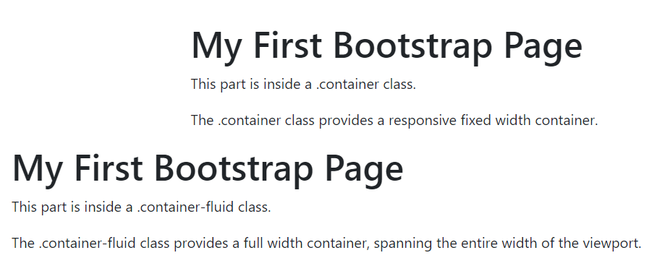
Container Classes
You should see the following:
.container provides a responsive fixed width container
.container-fluid provides a responsive full width container

Slide 13
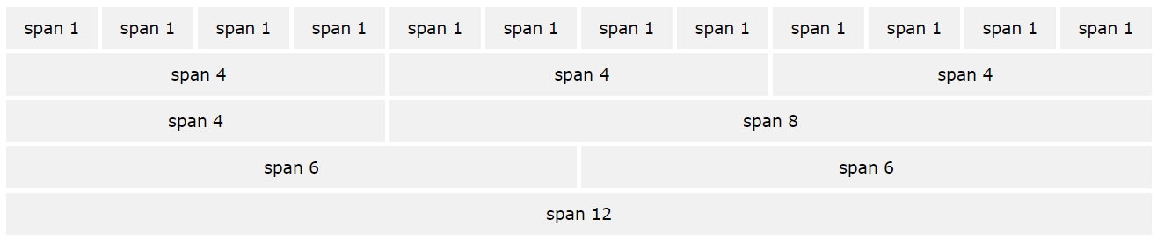
Grid Classes
The grid system is made up of 12 columns across the page
We can group the columns together to create wider columns

Slide 14
Grid Classes
Bootstrap has 5 grid classes
.col (extra small devices – screen width < 576px)
.col-sm (small devices – screen width >= 576px)
.col-md (medium devices – screen width >= 768px)
.col-lg (large devices – screen width >= 992px)
.col-xl (xlarge devices – screen width > 1200px)

Slide 15
Grid Classes
Add the following codes to the bootstrap_example.html file inside the <body> element to create 4 equal columns in the page
Refresh the web page again, you should see 4 columns created in the page
Resize your browser, you should see that the columns resize accordingly too
<div class="row">
<div class="col" style="background-color:lavender;">column 1</div>
<div class="col" style="background-color:lavenderblush;">column 2</div>
<div class="col" style="background-color:lavender;">column 3</div>
<div class="col" style="background-color:lavenderblush;">column 4</div>
</div>

Slide 16
Grid Classes
Next, add the following codes to the bootstrap_example.html file inside the <body> element to create 4 equal columns in the page
<div class="row">
<div class="col-sm-3" style="background-color:lavender;">sm column 1</div>
<div class="col-sm-3" style="background-color:lavenderblush;">sm column 2</div>
<div class="col-sm-3" style="background-color:lavender;">sm column 3</div>
<div class="col-sm-3" style="background-color:lavenderblush;">sm column 4</div>
</div>
.col-sm-3 the columns will stack on top of each other when the screen width is lesser than 576px (sm-small devices)
.col-sm-3 there are 12 columns in a row, by putting -3, it means the columns are grouped in 3s, we have 4 columns of 3s here, so 4 * 3 = 12 columns in total

Slide 17
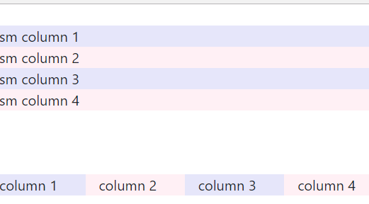
Grid Classes
Refresh the page and resize your browser
You should see that the columns will automatically stack on top of each other when the screen size goes below 576px wide

Slide 18
Text Colors
Text colors
some classes for text colors are: .text-muted , .text-primary , .text-warning , .text-danger
Add the following codes to bootstrap_example.html
<p class="text-muted">This text is muted.</p>
<p class="text-primary">This text is primary.</p>
<p class="text-warning">This text represents a warning.</p>
<p class="text-danger">This text represents danger.</p>

Slide 19
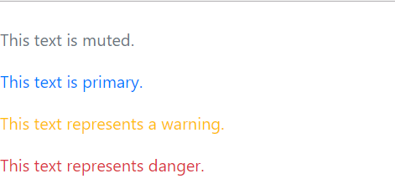
Text Colors
Refresh the page to see the difference in text colors

Slide 20
Background Colors
Background colors
some classes for background colors are: .bg-primary , .bg-secondary ,
.bg-warning , .text-danger
Add the following codes to bootstrap_example.html
<p class="bg-primary text-white">This bg is primary.</p>
<p class="bg-secondary text-white">This bg is secondary.</p>
<p class="bg-warning text-white">This bg is warning.</p>
<p class="bg-danger text-white">This bg is danger.</p>
Using 2 classes at the same time, one for the background color of the text, the other for the text color.

Slide 21
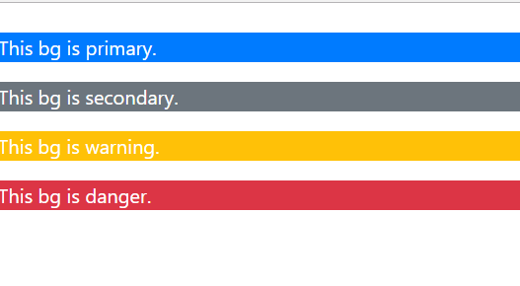
Background Colors
Refresh the page to see the difference in background colors

Slide 22
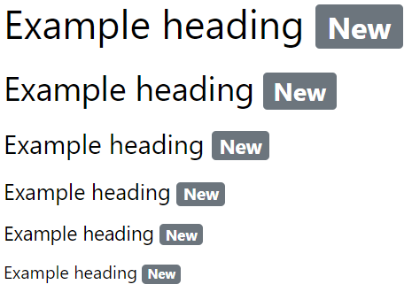
Badge
Badges are used to add additional information to any content
Use the .badge class within <span> elements to create rectangular badges
Badges scale to match the size of the parent element (if any)

Slide 23
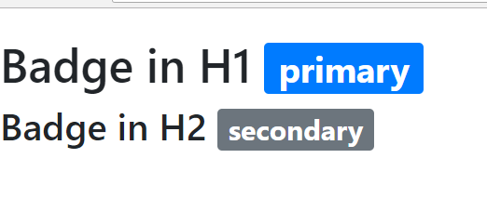
Badge
Add the following codes to bootstrap_example.html
<h1>Badge in H1 <span class="badge badge-primary">primary</span></h1>
<h2>Badge in H2 <span class="badge badge-secondary">secondary</span></h2>
.badge creates the badge
.badge-secondary determines the color of the bage

Slide 24
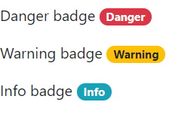
Badge
Add the following codes to bootstrap_example.html
<p>Danger badge <span class="badge badge-pill badge-danger">Danger</span></p>
<p>Warning badge <span class="badge badge-pill badge-warning">Warning</span></p>
<p>Info badge <span class="badge badge-pill badge-info">Info</span></p>
.badge-pill makes the edges of the badge rounder

Slide 25
BOOTSTRAP 4: Modals

Slide 26
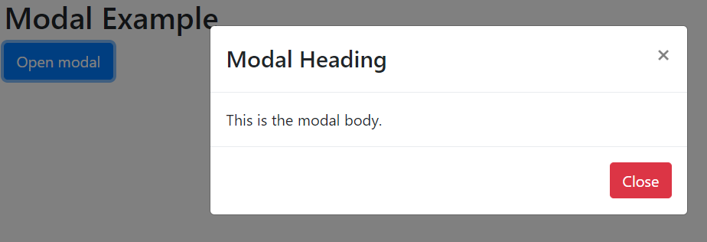
Modal
The Modal component is a dialog box/popup window that is displayed on top of the current page

Slide 27
Create a web page with Bootstrap 4
Create a new HTML file in your C:\Users\USERNAME\Desktop\cdev\week2\ bootstrap_modal.html
<!DOCTYPE html>
<html lang="en">
<head>
<meta charset="UTF-8">
<meta http-equiv="X-UA-Compatible" content="IE=edge">
<meta name="viewport" content="width=device-width, initial-scale=1.0">
<title>Bootstrap Modal</title> <link rel="stylesheet" href="https://maxcdn.bootstrapcdn.com/bootstrap/4.1.3/css/bootstrap.min.css">
<script src="https://ajax.googleapis.com/ajax/libs/jquery/3.3.1/jquery.min.js"></script>
<script src="https://maxcdn.bootstrapcdn.com/bootstrap/4.1.3/js/bootstrap.min.js"></script>
</head>
<body>
</body>
</html>

Slide 28
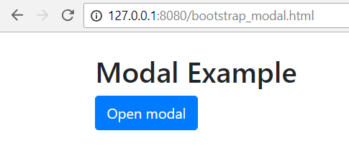
Modal
Create a button within the <body> element
<body>
<div class="container">
<h2>Modal Example</h2>
<!-- Button to Open the Modal -->
<button type="button" class="btn btn-primary" data-toggle="modal" data-target="#myModal">
Open modal
</button>
</div>
</body>
.btn-primary determines color of the button
data-toggle set to display a modal
data-target set to launch data in the <div> with the id “myModal”

Slide 29
Modal
Continue to create the modal within the <div class=“container”> element
The code above creates the modal dialog (the popup dialog box)
<!-- The Modal -->
<div class="modal" id="myModal">
<div class="modal-dialog">
<div class="modal-content">
</div>
</div>
</div>

Slide 30
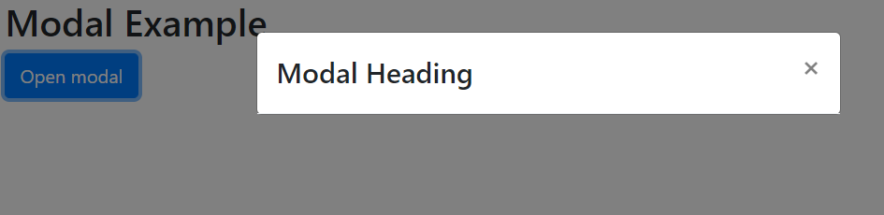
Modal
Create the modal header within the <div class=“modal-content”> element
The code above creates the modal header, click on the “Open Modal” button to view the modal
<!-- Modal Header -->
<div class="modal-header">
<h4 class="modal-title">Modal Heading</h4>
<button type="button" class="close" data-dismiss="modal">&times;</button>
</div>
&times; creates the “x” sign in the button

Slide 31
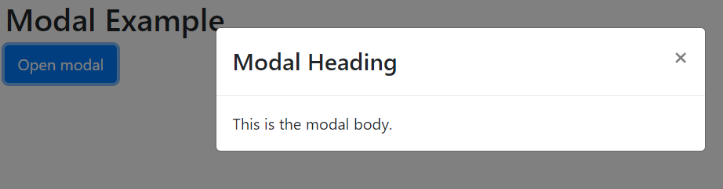
Modal
Create the modal body within the <div class=“modal-content”> element
This is where the actual contents of the modal should be
<!-- Modal body -->
<div class="modal-body">
This is the modal body.
</div>

Slide 32
Modal
Lastly, create the modal footer within the <div class=“modal-content”> element
The code above creates the modal footer with a red close button
<!-- Modal footer -->
<div class="modal-footer">
<button type="button" class="btn btn-danger" data-dismiss="modal">Close</button>
</div>
data-dismiss is used to close the modal

Slide 33
BOOTSTRAP 4: navbar

Slide 34
Navbar
A navigation bar is a navigation header that is placed at the top of the page
A standard navigation bar is created with the .navbar class

Slide 35
Create a web page with Bootstrap 4
Create a new HTML file in your C:\Users\USERNAME\Desktop\cdev\week2\ bootstrap_navbar.html
<!DOCTYPE html>
<html lang="en">
<head>
<meta charset="UTF-8">
<meta http-equiv="X-UA-Compatible" content="IE=edge">
<meta name="viewport" content="width=device-width, initial-scale=1.0">
<title>Bootstrap Navbar</title> <link rel="stylesheet" href="https://maxcdn.bootstrapcdn.com/bootstrap/4.1.3/css/bootstrap.min.css">
<script src="https://ajax.googleapis.com/ajax/libs/jquery/3.3.1/jquery.min.js"></script>
<script src="https://maxcdn.bootstrapcdn.com/bootstrap/4.1.3/js/bootstrap.min.js"></script>
</head>
<body>
</body>
</html>

Slide 36
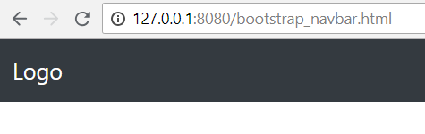
Navbar
Create a navbar within the <body> element
.navbar creates the navigation bar
.navbar-expand-sm stacks the links up if the screen width is less than 576px
.navbar-dark and .bg-dark made the navigation bar appears in dark gray
<body>
<nav class="navbar navbar-expand-sm bg-dark navbar-dark">
<!-- Brand/logo -->
<a class="navbar-brand" href="#">Logo</a>
</nav>
</body>
.navbar-brand highlights the brand/logo/name of your page

Slide 37
Navbar
Create hyperlinks in the navbar by typing the following codes:
To add links inside the navbar, use a <ul> element with class="navbar-nav". Then add <li> elements with a .nav-item class followed by an <a> element with a .nav-link class
<!-- Links -->
<ul class="navbar-nav">
<li class="nav-item">
<a class="nav-link" href="http://www.tp.edu.sg">Temasek Polytechnic</a>
</li>
<li class="nav-item">
<a class="nav-link" href="http://lms.tp.edu.sg">LMS</a>
</li>
<li class="nav-item">
<a class="nav-link" href="http://www.google.com">Google</a>
</li>
</ul>

Slide 38
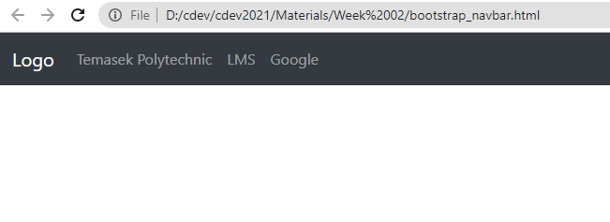
Navbar
Refresh the page to see the navbar

Slide 39
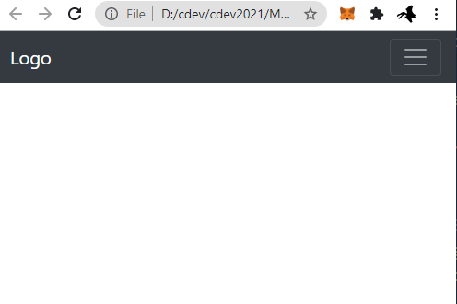
Collapsible Navbar
Next, we will make some changes to the codes to make a collapsible Navbar when the screen size decreases to smaller than 576px

Slide 40
Collapsible Navbar
Create a button above the links
This button will only appear when the width of the screen decreases to lesser than 576px
<!-- Toggler/collapsible Button -->
<button class="navbar-toggler" type="button" data-toggle="collapse" data-target="#collapsibleNavbar">
<span class="navbar-toggler-icon"></span>
</button>

Slide 41
Collapsible Navbar
Next, we need to create a <div> and place the links to be inside this <div>
<!-- Links -->
<div class="collapse navbar-collapse" id="collapsibleNavbar">
<ul class="navbar-nav">
.
.
.
.
</ul>
</div>

Slide 42
Collapsible Navbar
Now, you can refresh the web page again, resize your browser to see the collapsible navbar

Slide 43
The End

